Slide 1



BT2102
ASSIGNMENT 2
Group 35:
Agarwal Yuvika || Cheng Zhen Yu || Lee How Xi
Mahika Khandelwal || Ng Zong Hern, Caleb || Ranga Sahasra

Slide 2

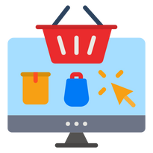



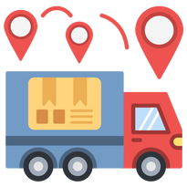

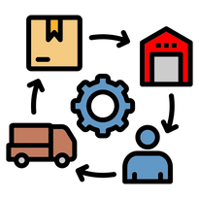
About Olist
Empowers Small Medium Businesses (SMBs)
Streamlines operations
Reduces Costs
Enhances Customer Satisfaction
Optimize Supply Chain Management (SCM)

Slide 3

Data Cleaning & Processing
Study dataset & identify data types of each column
Validate all data entries
1
4
Handle missing values (NULL values - excluded because of unknown / undisclosed reason(s) behind the nullities)
2
5
Standardize data
Remove any exact duplicates of tuples
Use visualizations to identify outliers, and decide further actions
(exploratory data analysis)
3
6

Slide 4
Business Questions
Overall Business Performance
Level 2: How did Olist fare in terms of its business performance for 2016-2018?
Level 3: What is Olist’s business performance in terms of monthly sales volume?
Level 3: What is Olist’s business performance in terms of monthly platform score?
Level 3: What is Olist’s business performance in terms of monthly revenue?
Level 3: What is Olist’s business performance in terms of customer base growth?
Level 3: What is Olist’s business performance in terms of seller fleet growth?
Products/Merchants
Level 2: Which product categories perform best and how do trends impact performance?
Level 3: Which product categories have the highest order volume?
Level 3: Which product categories generate the highest revenue?
Level 3: Which product categories have higher review scores / generate higher consumer satisfaction?
Level 3: What product categories drive repeat purchases?
Level 3: What seasonal trends of sales volume do different product categories exhibit?
Level 2: How do refund-related orders vary across different months in the year?
Level 3: What could be the underlying reasons for the peaks in refund-related orders during certain months?

Slide 5
Business Questions II
Customers
Level 2: What are the key pain points for customers?
Level 3: What are the common issues highlighted in poor reviews, say of review score (< 2.5)?
Level 4: If and how does length of delivery delay impact review scores?
Logistics
Level 2: How does freight cost differ across Brazil?
Level 3: Which state(s) experience(s) lower freight cost?
Level 3: Which state(s) experience(s) most delivery delay?
Level 4: What is the geographical distribution of sellers?
Level 4: What is the geographical distribution of buyers?
Payment
Level 2: What is the proportion of payment types amongst the orders?
Level 3: What are the most used product types and how can we capitalize on these types to drive customers to order more?

Slide 6
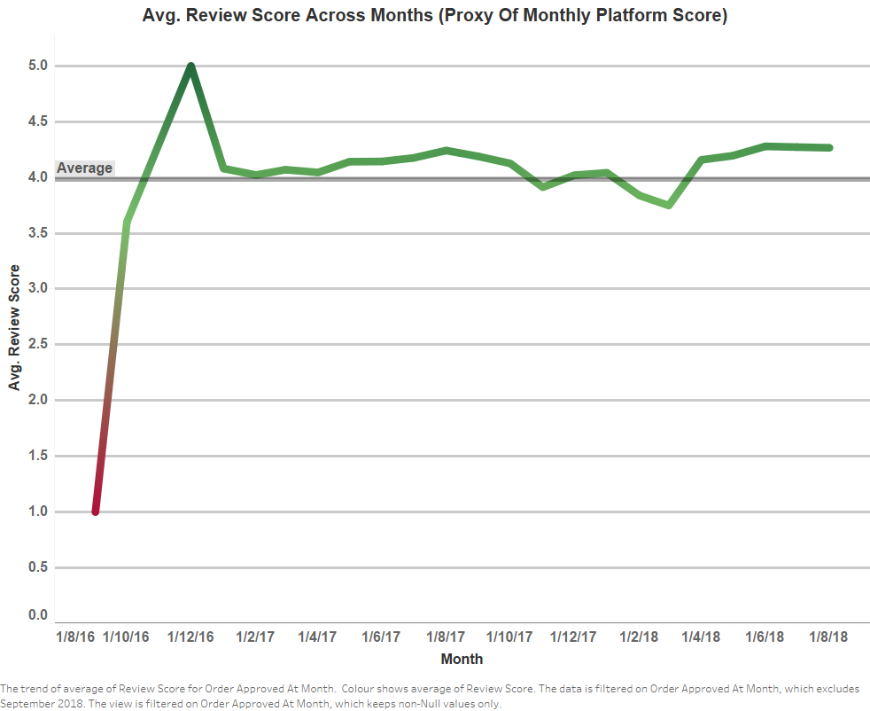

L2: What is Olist’s overall business performance?
L3: In terms of monthly platform score?
Olist faces the reality of stalled business quality growth in terms of non-improving platform score.
Platform popularity plateau and hover around 4.0, indicating need to focus on quality service delivery to break past the bounded range
Platform rapidly gains popularity with initial excitement from users

Slide 7
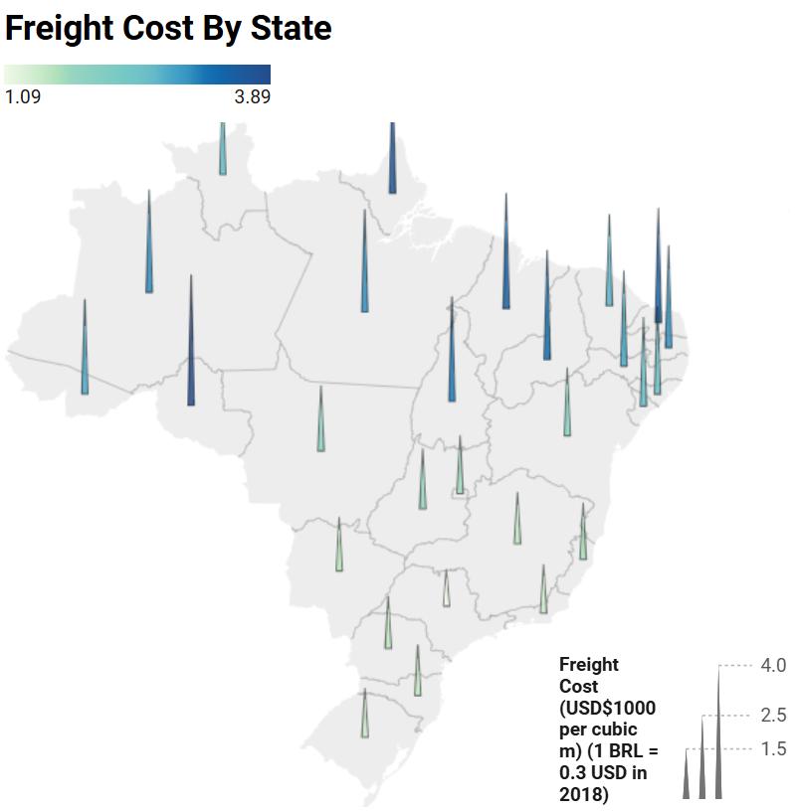
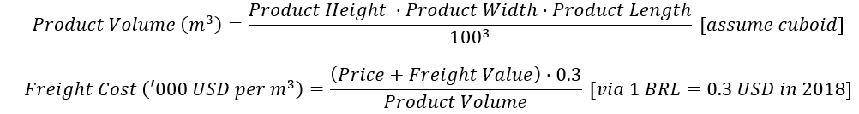

L2: How does freight cost differ across Brazil?
L3: Which state(s) experience(s) higher freight cost?
Southern states are more urbanized therefore have more well-built logistics and transport infrastructure. They are also likely the locations where Olist warehouses are set-up.
São Paulo (SP), Brazil’s logistics hub has lowest freight cost => suitable place to fortify user base and presence

Slide 8
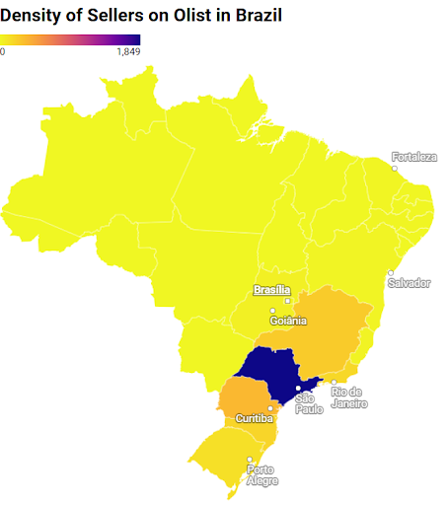
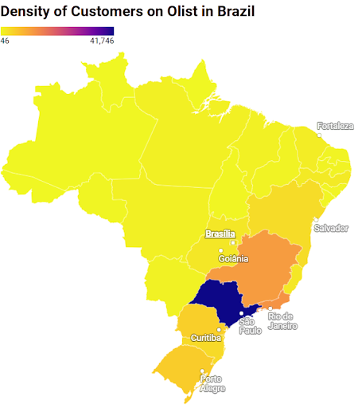
L2: How does freight cost differ across Brazil?
L4: What is the geographical distribution of sellers and buyers? [state-wise]
SP has the highest concentration of sellers and buyers by a large margin
Viable hotspot location for business improvement (to devote resources to)

Slide 9
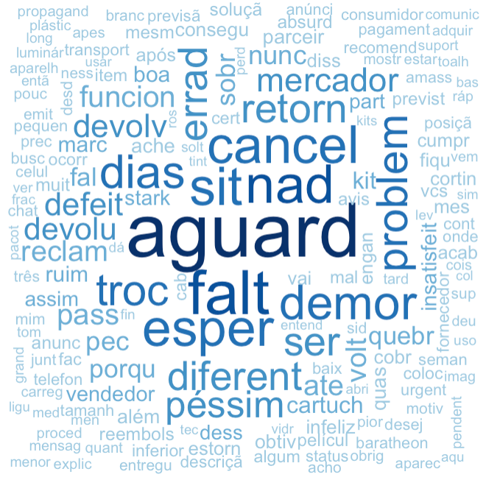
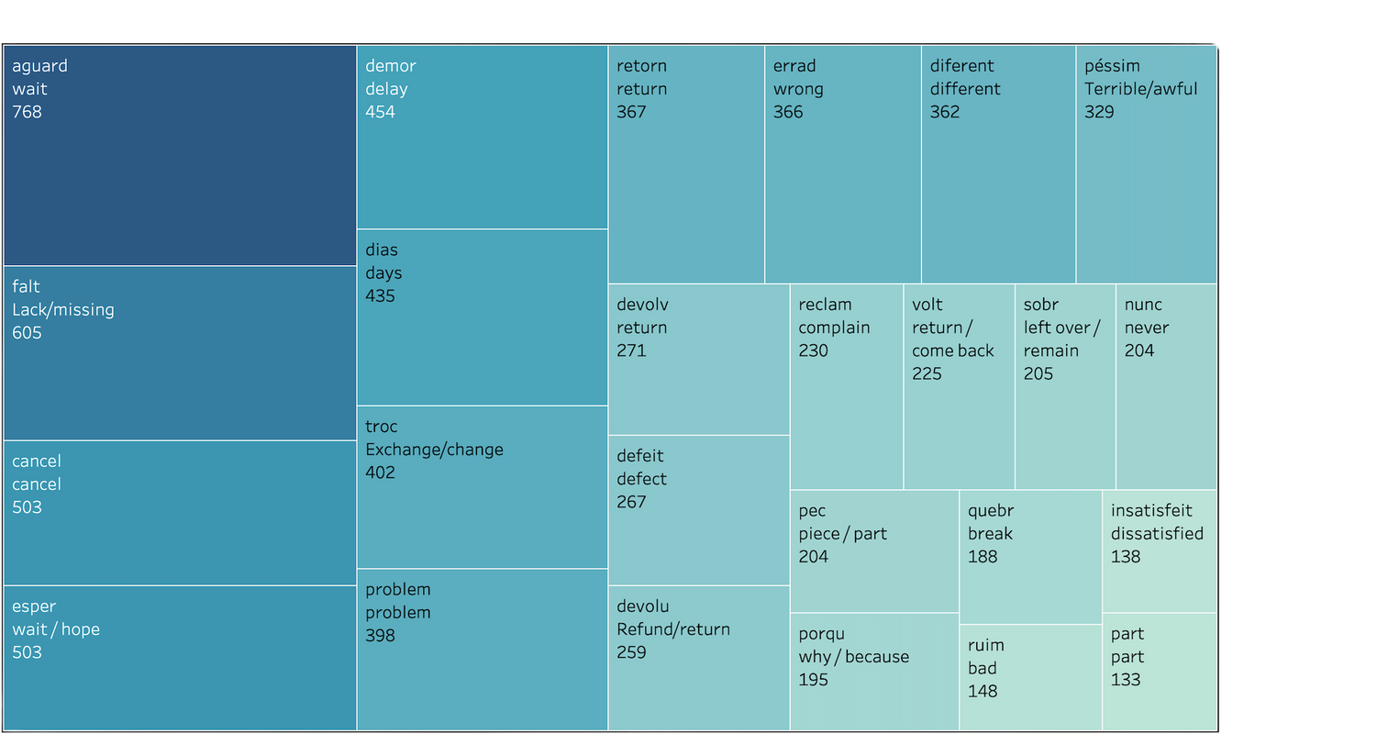


L2: What are the key pain points for customers?
L3: What are the common issues identified in reviews?
Delivery delay is highlighted as the top most pertinent concern and dissatisfaction amongst customers as the negative words such as aguard (‘wait’ in English), are used most frequently, amongst other secondary issues like product refunds.
Wordcloud of Top Negative Words in Reviews
Treemap Of the Count of Top Negative Words in Reviews

Slide 10
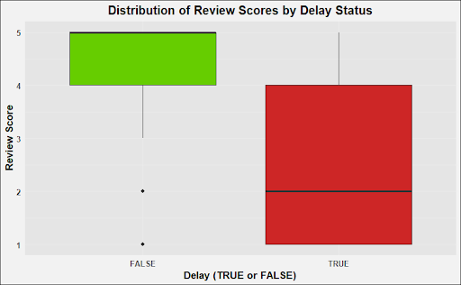
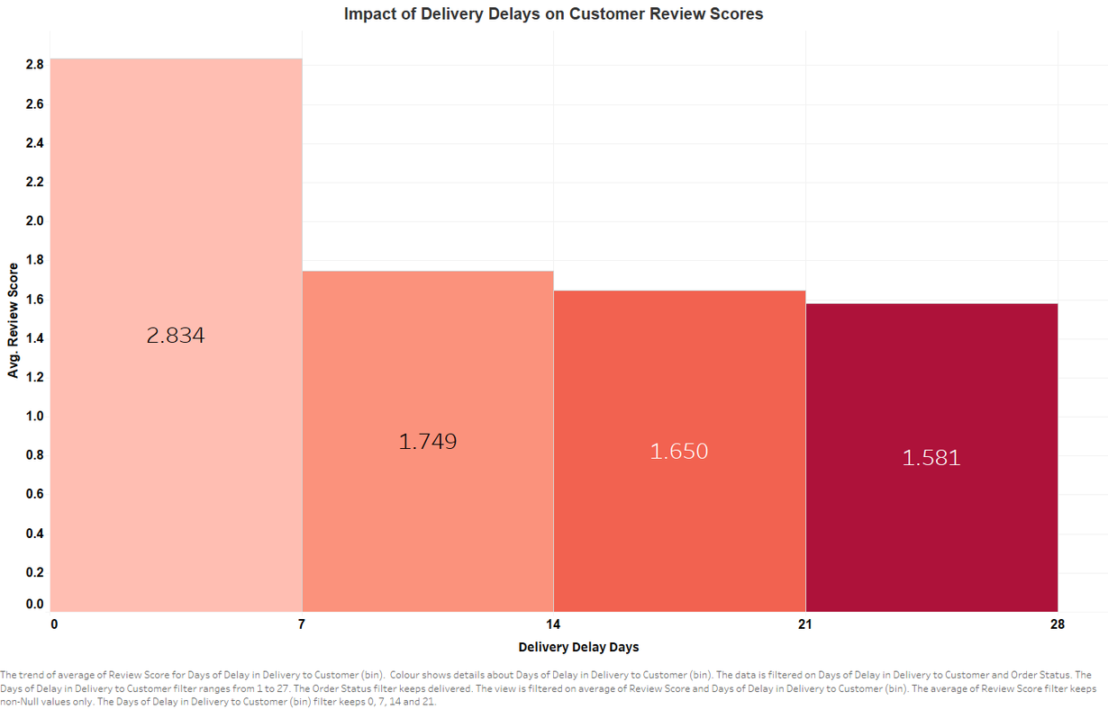
L2: What are the key pain points for customers?
L4: If and how does length of delivery delay impact review scores?
Big dip in review score from 2.8 to <2 happens beyond 1-week mark of delivery
Customer tolerance to delivery delay is up to 7 days.
Delivery delay has negatively impacted quantitative review scores
(median of 5 drops to median of 2)

Slide 11
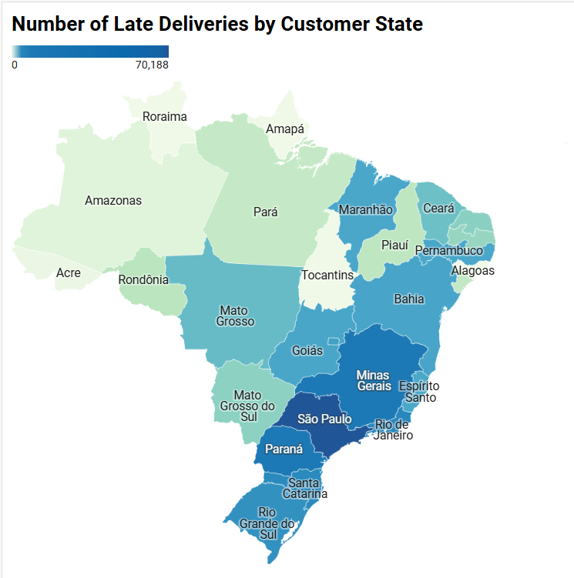
L3: Which state(s) experience(s) most delivery delay?
High Late Deliveries in the Southeast & South:
States like São Paulo, Minas Gerais, and Rio de Janeiro have the darkest shades, indicating the highest number of late deliveries. This aligns with the fact that these regions have the largest population and highest volume of e-commerce activity.
Logistical & Infrastructure Challenges:
The disparity in late deliveries reflect differences in infrastructure, warehouse distribution, and delivery efficiency across states.
Highest frequency of late deliveries in the Southeast and South states

Slide 12
Strategy 1: Strengthen Sao Paulo (SP) Logistics
Rationale: Centralization of user base and logistics partners
Most Olist sellers and customers originate from SP.
SP is the logistics hub of Brazil, thus more freight options and connectivity
(a) Communication with existing logistics partners:
Set KPI in agreement clause to limit delivery delay to within 7 days, with compensation if beyond 7 days
(b) Formalise SP taskforce to resolve customer dissatisfaction
Introduce live chat or chatbot features to address customer issues promptly
Regularly monitor frequency of negative keywords (e.g. aguard) to track logistical improvement
(c) Beyond existing logistics partners:
Source for last-minute hyper logistics services to improve fulfil order with minimal delay
Bypass the need for logistics: Collaborate with local post offices / Sao Paulo Metro to establish self-collection centres in SP

Slide 13
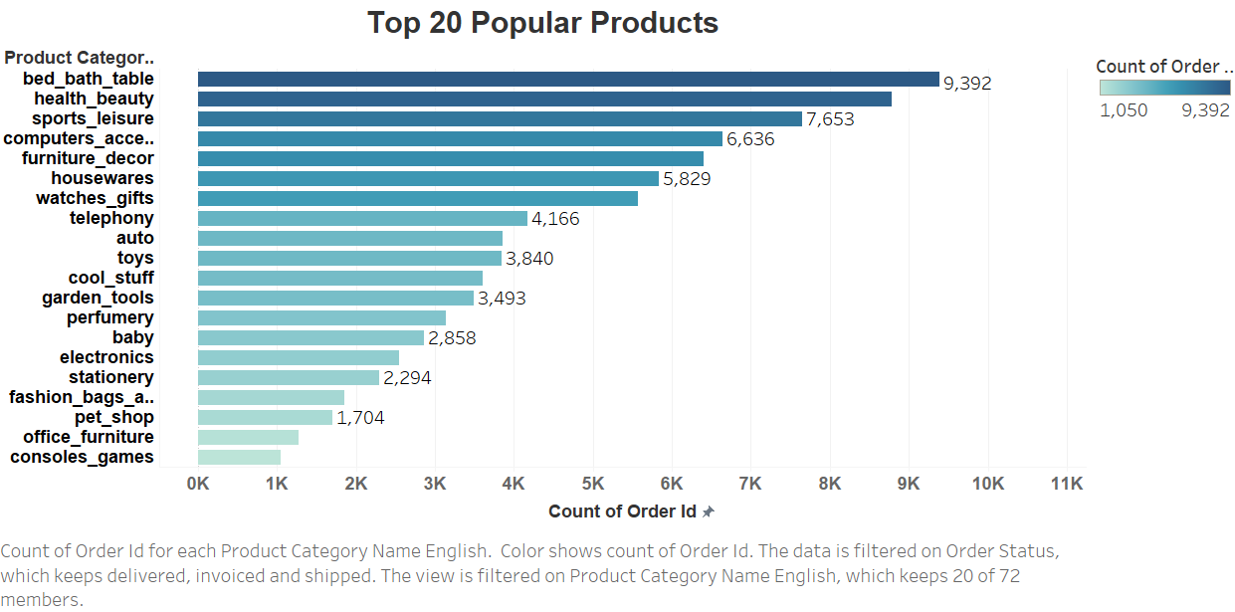
L2: Which product categories perform best and how do trends impact performance?
L3: Which product categories generate the highest order volume?
Home-Focused Consumer Preference:
Four of the top six categories, indicating strong consumer interest in home-related items.
Order Count

Slide 14
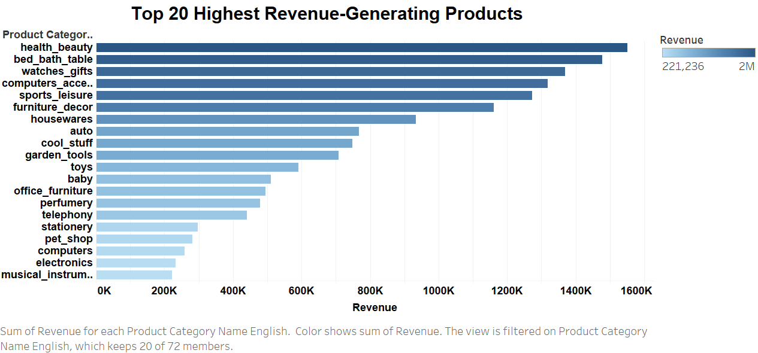
L2: Which product categories perform best and how do trends impact performance?
L3: Which product categories have the highest revenue?
Classification based on the graph
Premium Category: categories showing higher revenue positions than order count positions (watches_gifts, auto, cool_stuff)
Volume-driven Category: bed_bath_table and sports_leisure derive their revenue strength primarily from high transaction counts rather than high unit values.
Revenue Calculation = [Price] × Count[Order item ID]
Notes:
too big, gotta either filter it down or make it horizontal to fit the slide.

Slide 15
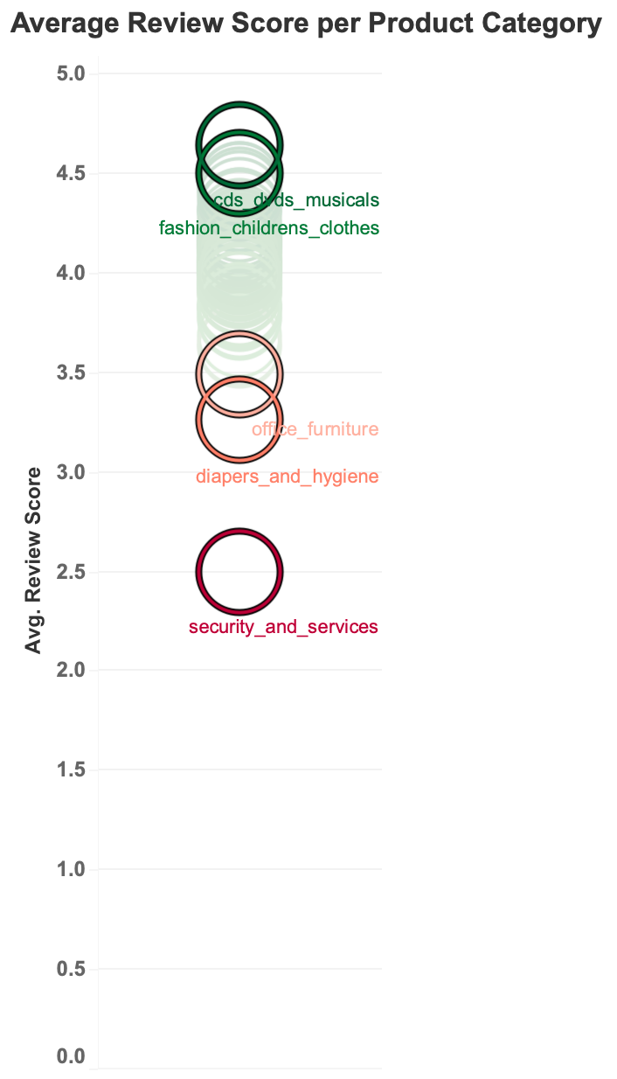


L2: Which product categories perform best and how do trends impact performance?
L3: Which product categories have higher review scores / generate higher consumer satisfaction?
Product categories such as CDs DVDs musicals and fashion clothing perform best in terms of highest average review scores => Olist to perform increased platform exposure (incentive / reward)
Product categories such as security and diapers & hygiene perform poorest in terms of lowest average review scores => Olist to perform more stringent seller vetting processes and audits for listers in these categories.

Slide 16
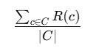
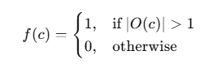
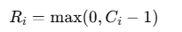
L3: What product categories drive repeat purchases?
Repurchase Rate Calculation
SUM([Repurchase Flag]) / COUNTD([Customer Unique Id])
C be the set of all unique customers.
R(c) be the repurchase flag for customer ccc, where R(c)=1 if the customer has repurchased and 0 otherwise.
|C| denote the count of distinct customers.
Number of Repurchase calculation
Repurchase Flag Calculation
{ FIXED [Customer Unique Id]: COUNTD([Order Id]) } - 1
IF { FIXED [Customer Unique Id]: COUNTD([Order Id]) } > 1 THEN 1 ELSE 0 END
Ri: repurchase count
Ci: the distinct number of orders made by i
c be the set of all unique customer IDs
O(c) is the distinct order ID associated with customer c
Notes:
not sure why i the image i managed to get from the doc was q fuzzy, might need to re-upload.
dk if you guys want to use the dual bar graph in the explanation, just left it there first, up to presenter
must rearrange / remove before presentation

Slide 17
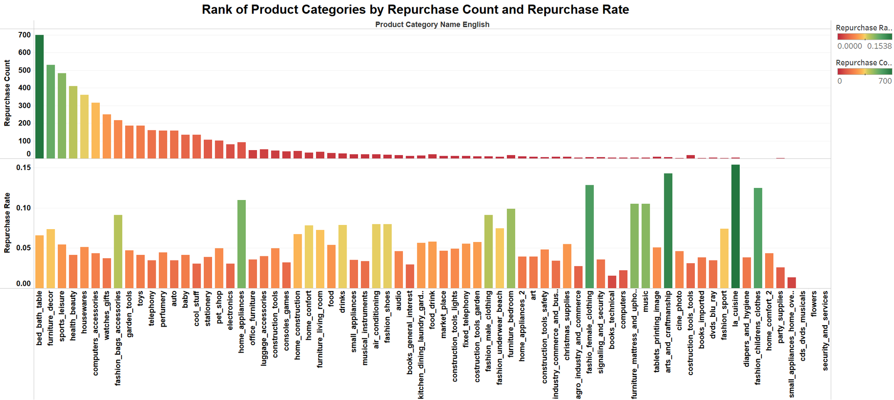
L3: What product categories drive repeat purchases?
Arts and crafts lead with a 16% repurchase rate, followed by fashion and female clothing (12-14%). Most categories fall below 6%. Bed and bath products drive the most repeat purchases (~600 repurchases), followed by furniture and sports/leisure. This ranking differs from repurchase rate rankings, suggesting that some categories achieve more repeat purchases through high order volume rather than customer loyalty.
Notes:
not sure why i the image i managed to get from the doc was q fuzzy, might need to re-upload.
dk if you guys want to use the dual bar graph in the explanation, just left it there first, up to presenter
must rearrange / remove before presentation

Slide 18
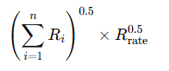
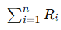
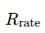
L3: What product categories drive repeat purchases?
Repurchase Score Calculation
Justification
To examine and identify which product categories are performing well in terms of repurchase, we create a repurchase score that assesses both the repurchase rate and the number of repurchases together.
Taking the square root of both the repurchase count and repurchase rate normalizes extreme values, preventing any one factor from dominating the score. This ensures that both metrics contribute equally, reflecting a balanced relationship between them. The multiplicative approach highlights the importance of both the number of repurchases and the repurchase rate, ensuring a holistic assessment of product performance. A product with high repurchase count but low rate will score lower than one with a balanced performance in both areas.
POWER(SUM([Repurchase Count]), 0.5) * POWER([Repurchase Rate], 0.5)
represents the sum of repurchase counts (for nnn instances)
represents the repurchase rate.
Notes:
not sure why i the image i managed to get from the doc was q fuzzy, might need to re-upload.
dk if you guys want to use the dual bar graph in the explanation, just left it there first, up to presenter
must rearrange / remove before presentation

Slide 19
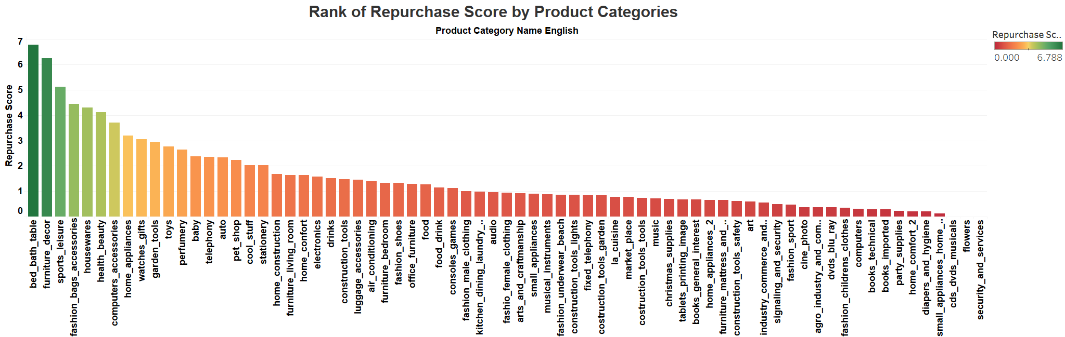
L3: What product categories drive repeat purchases?
The product categories show distinct groupings based on repurchase scores:
Top performers (5-7 range): Bed/bath, furniture, sports, bags/accessories, home wares
Mid-range performers (2-4 range): Home appliances, watches, garden tools, toys, perfumery
Low performers (<2 range): Most electronics, clothing items, and specialized categories
Notes:
not sure why i the image i managed to get from the doc was q fuzzy, might need to re-upload.
dk if you guys want to use the dual bar graph in the explanation, just left it there first, up to presenter
must rearrange / remove before presentation

Slide 20
Sub-Strategy 2a: Strategic Resource Allocation
Top Performers (Repurchase Score: 5-7):
Categories like Bed & Bath, Furniture, Sports, Bags/Accessories, and Home Wares show strong customer loyalty and growth potential. Prioritize marketing and inventory resources to enhance visibility and capitalize on repeat business.
Mid-Range Performers (Repurchase Score: 2-4):
Categories such as Home Appliances, Watches, Garden Tools, Toys, and Perfumery exhibit moderate repurchase behaviour. Focus on targeted marketing and product optimization to improve retention and increase purchase frequency.
Low Performers (Repurchase Score: <2):
Categories like Electronics, Clothing, and Specialized Items show low repurchase rates. Assess the reasons behind this and consider refining offerings, exploring new acquisition strategies, or reducing investment in underperforming segments.

Slide 21
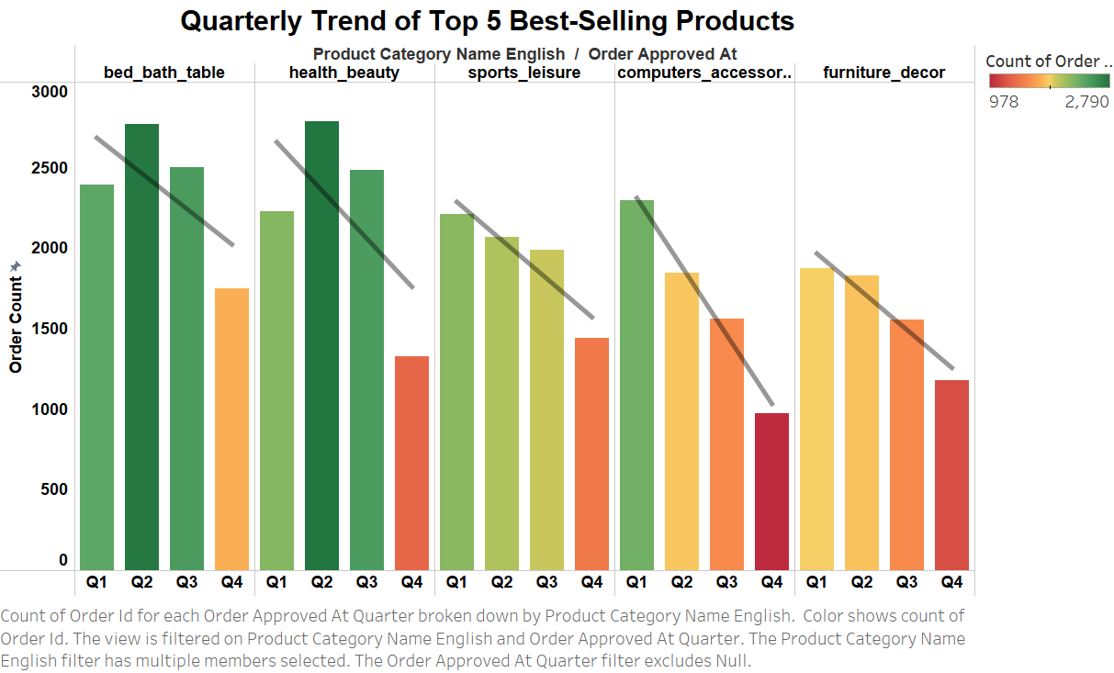
L2: Which product categories perform best and how do trends impact performance?
L3: What seasonal trends of sales volume do different product categories exhibit?
The graph shows the quarterly trend of 5 most popular products. From the graph, we can observe:
Overall Declining Trend
Seasonal Spike in Q2
Q4 Performance Drop

Slide 22
Sub-Strategy 2b: Dynamic Pricing Strategies
Peak Demand (Q2 - Seasonal Spike):
Increase prices during the seasonal spike in Q2 to maximize margins while maintaining demand.
Off-Peak (Q4 - Performance Drop):
Offer strategic discounts in Q4 to maintain sales, using tiered or bundled promotions to boost volume and retain customers.
Overall Decline:
Gradually lower prices over time to stay competitive and manage declining demand.

Slide 23
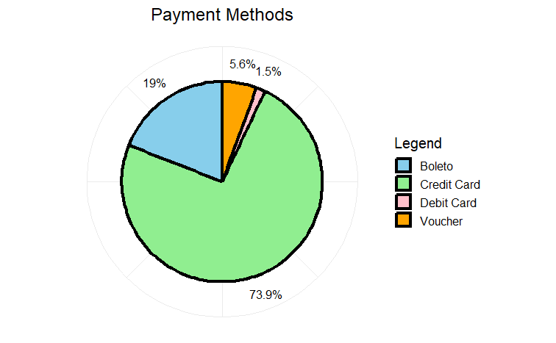
L2: What is the proportion of payment types amongst the orders?
L3: What are the most used payment types and how can we capitalize on these types to drive customers to order more?
Payment Methods
Large majority (73.9%) of customers pay by credit card, with Boleto being the runner-up at just 19%. Capitalize on the psychology of credit card swiping via partnerships and provide longer deadline for Boleto payments to increase sales. Ensure current payment interface and infrastructure includes new in-trend payment types like Pix. (proactive approach)
Notes:
Could we maybe remove the 'payment methods' title from the graph just for the sake of the presentation?

Slide 24
Strategy 2: Olist Platform Optimization
Rationale: The platform itself can influence customer purchase behaviour.
Strategic fine-tuning of platform features can increase or create customer wants via boosted attractiveness and relevance of products (e.g. exploit network effect)
Making purchases easy, simple and convenient can increase purchase frequencies.
(a) AI-driven recommendation systems on application’s home page and order checkout page [product positioning] to enhance product delivery
Use ML algorithms to suggest historical purchases and encourage repeat buying.
Highlight top-selling products through banners and awards to leverage social proof. [customer signalling]
Feature discounted off-season items to address product seasonality.
Create product bundles combining high-volume and high-value items to increase average order value.
(b) Seamless Payment & Pricing Strategies:
Partner with local credit card companies for credit card payment discounts (price strategy)
Include new payment options like Pix

Slide 25
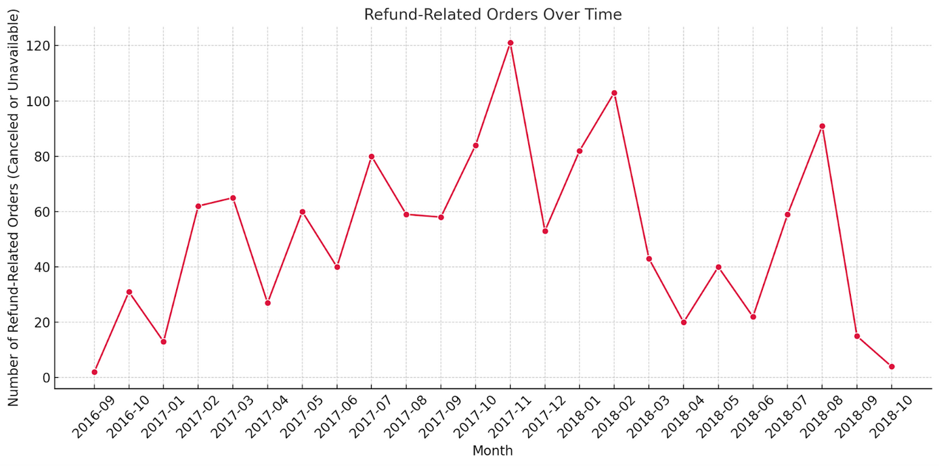

L2: How do refund-related orders vary across different months in the year?
L3: What could be the underlying reasons for the peaks in refund-related orders during certain months?
Refund-related orders (i.e., those marked as canceled or unavailable) show spikes during the holiday seasons — especially November and December. There is year-round activity, but the volume peaks toward the end of each year, likely tied to Black Friday, Christmas, and increased seasonal demand.

Slide 26
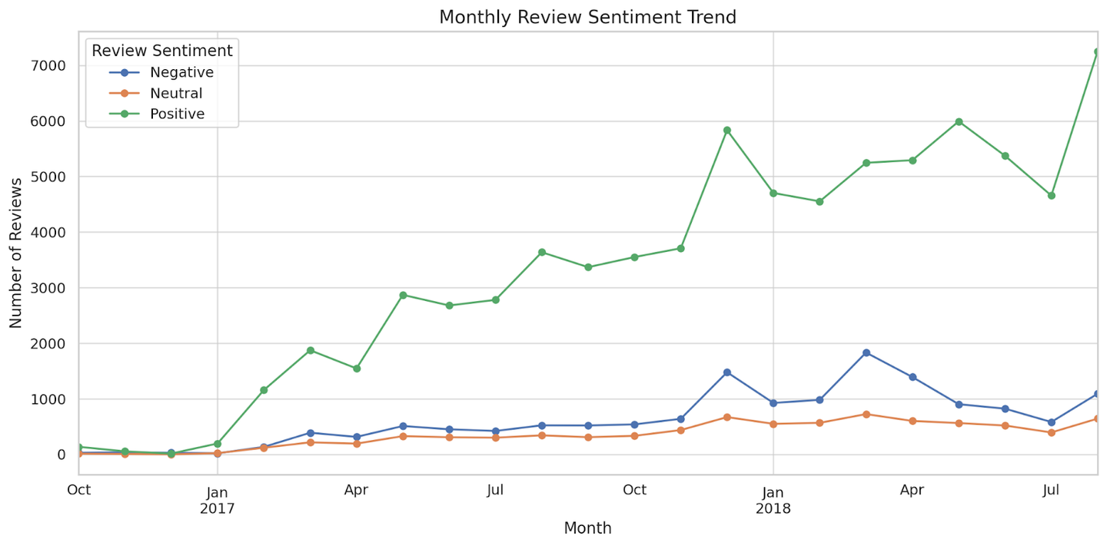
L2: How do refund-related orders vary across different months in the year?
L3: What could be the underlying reasons for the peaks in refund-related orders during certain months?
Majority of reviews are positive, but spikes in negative reviews occur in specific months.
Peaks observed in Feb, Nov, and Dec of 2017 & 2018.
These align with Brazilian events/holidays: Carnival, Black Friday, Christmas.
High order volumes during these periods likely strain logistics.
Results in delivery delays, stockouts, and service issues.
Indicates operational readiness lags behind demand surges.

Slide 27
Strategy 3: Operation SurgeShield
Scalable Logistics: Partner with additional couriers and temporary warehouses during peak seasons.
Inventory Buffering: Stock high-demand products in advance to prevent stockouts.
Customer Communication: Set realistic delivery expectations and provide proactive delay updates.
Performance Monitoring: Implement real-time tracking of delivery KPIs during high-volume months.
Post-Peak Feedback Loop: Analyze reviews post-peak to identify gaps and refine future responses.

Slide 28
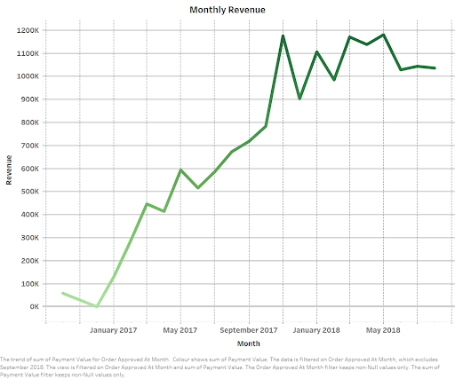
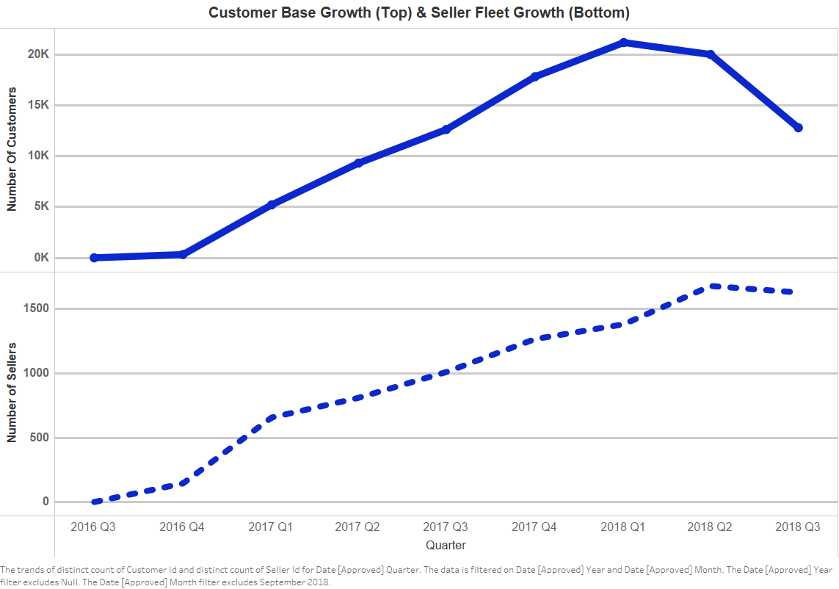

L2: What is Olist’s overall business performance?
L3: In terms of monthly revenue?
L3: In terms of seller fleet and customer base growth?
plateau
formation of global peak in 2018 Q1 and reversal into decreasing trend since
decelerating growth

Slide 29

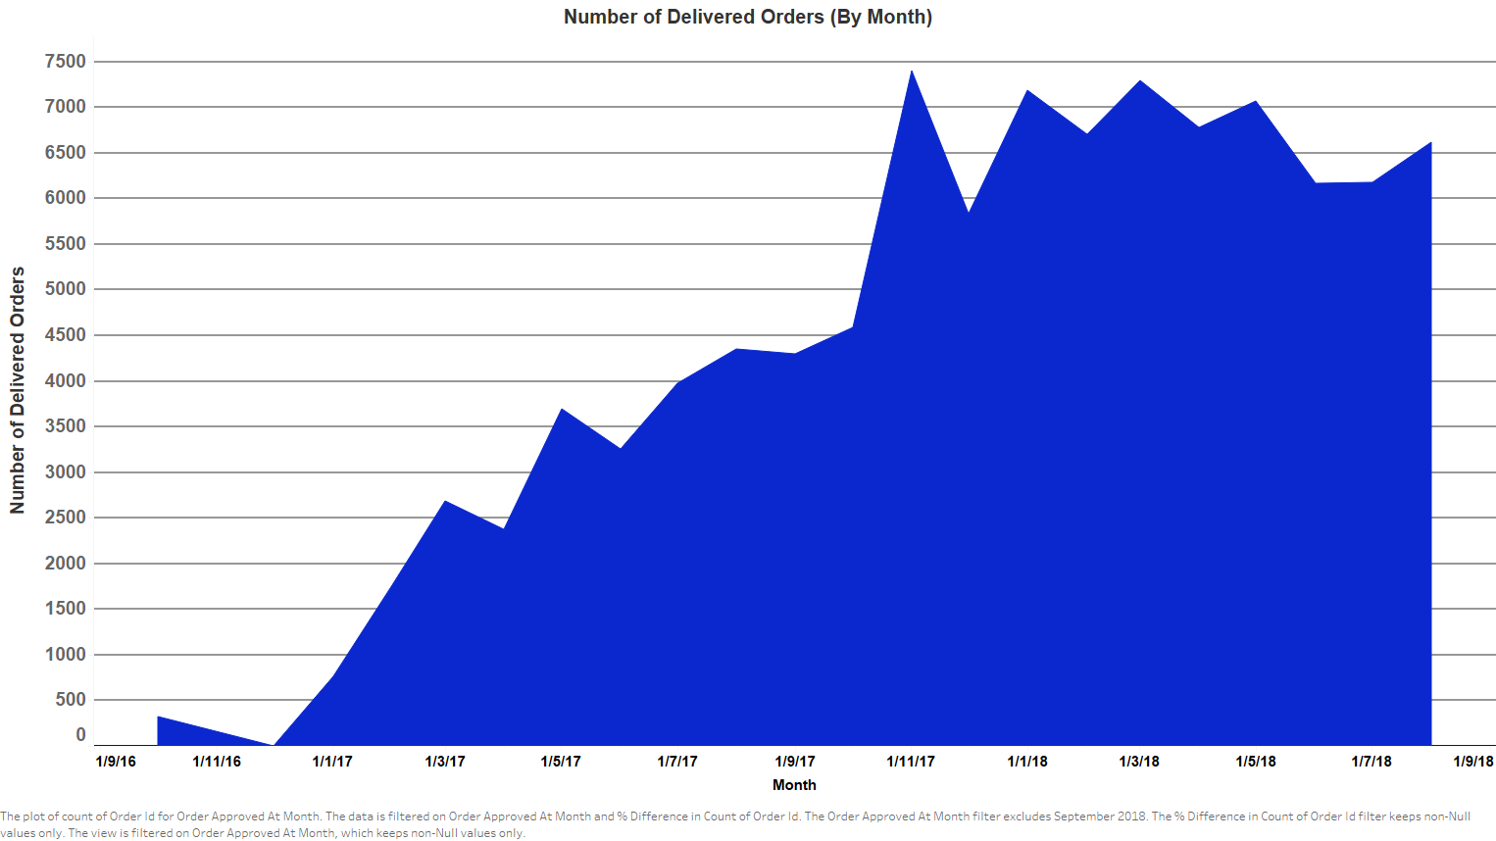
L2: What is Olist’s overall business performance?
L3: In terms of monthly sales volume?
plateau
All aforementioned performance metrics indicate that Olist's growth prospects are slowing and potentially fracturing, coupling with declining sales and user numbers.
Beyond SP, Olist should identify potential underserved and viable markets.

Slide 30
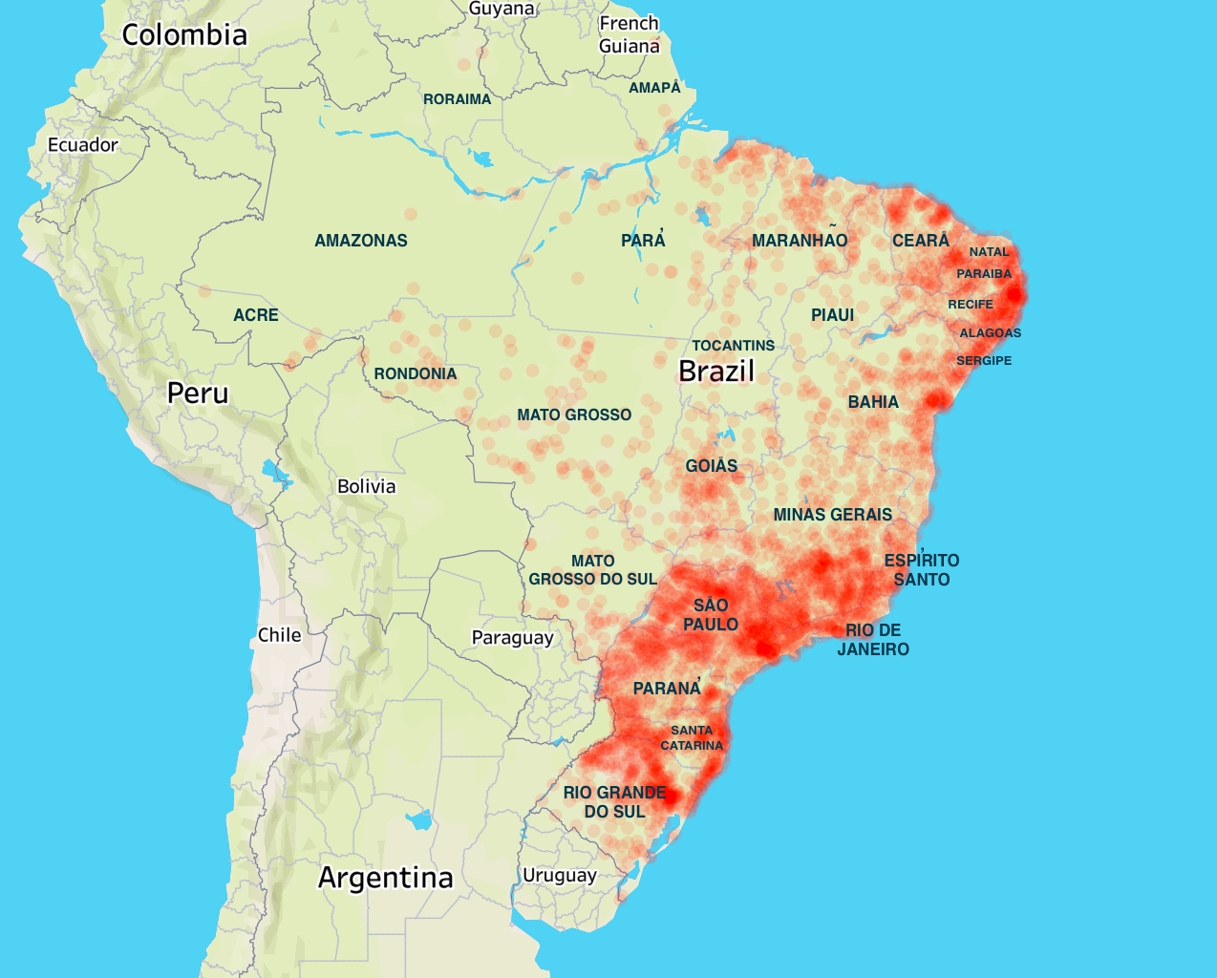
L2: What is Olist’s overall business performance?
L3: What is the geographical distribution of customers? [discrete-wise]
Coastal eastern cities such as Alagoas and Sergipe, belong to the 2nd hotspot location for customer origin, with shipping ports such as porte de saupe (5th largest).
Compared to SP (with Brazil’s busiest trade ports), the trade stress on industrial infrastructure on these cities are less (i.e. less congestion, less freight competition), therefore potentially less delivery delay.
Under-tapped business opportunity of bringing SP specialty beyond SP (potentially via intranational ship routes)

Slide 31
Strategy 4: Expansion of Presence Beyond SP
Rationale: Expand customer base and seller fleet can directly increase number of users of Olist platform.
Direct approach towards increasing sales volume and revenue
(a) Advertising of Olist platform in coastal Eastern cities [non-price strategy]
Via social media advertisement, road banners, etc.
Encourage local merchants to go online
(b) Establish local Olist service centres to ensure quality service delivery
Expansion comes with the need to maintain or better review scores (a measurement of service delivery standards)
Partnership with well-related local provincial carrier services to ensure swift delivery within the cities [vendor selection]

Slide 32
Thank You!
Any questions?

